Slide 1


ADVANCED INTEGRATED RESPONSE & AID ASSISTANT
Faster deployment of aid units and on-site emergency intervention using data-driven decisions

Slide 2
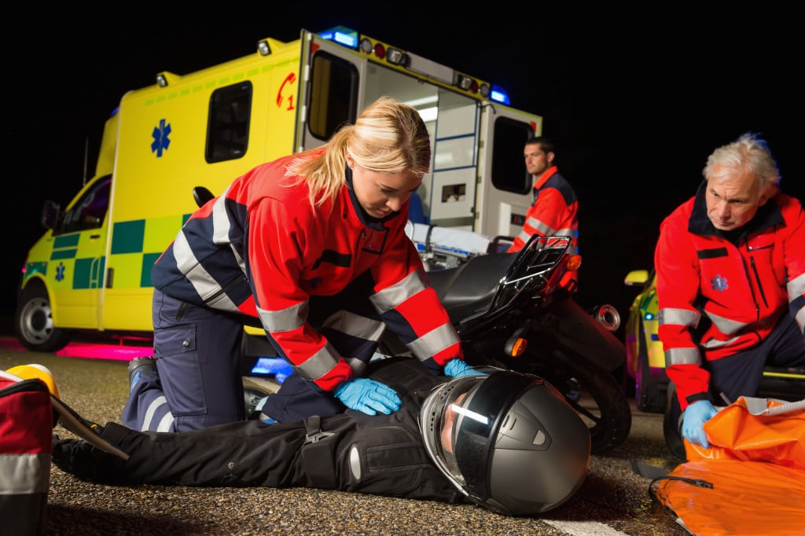
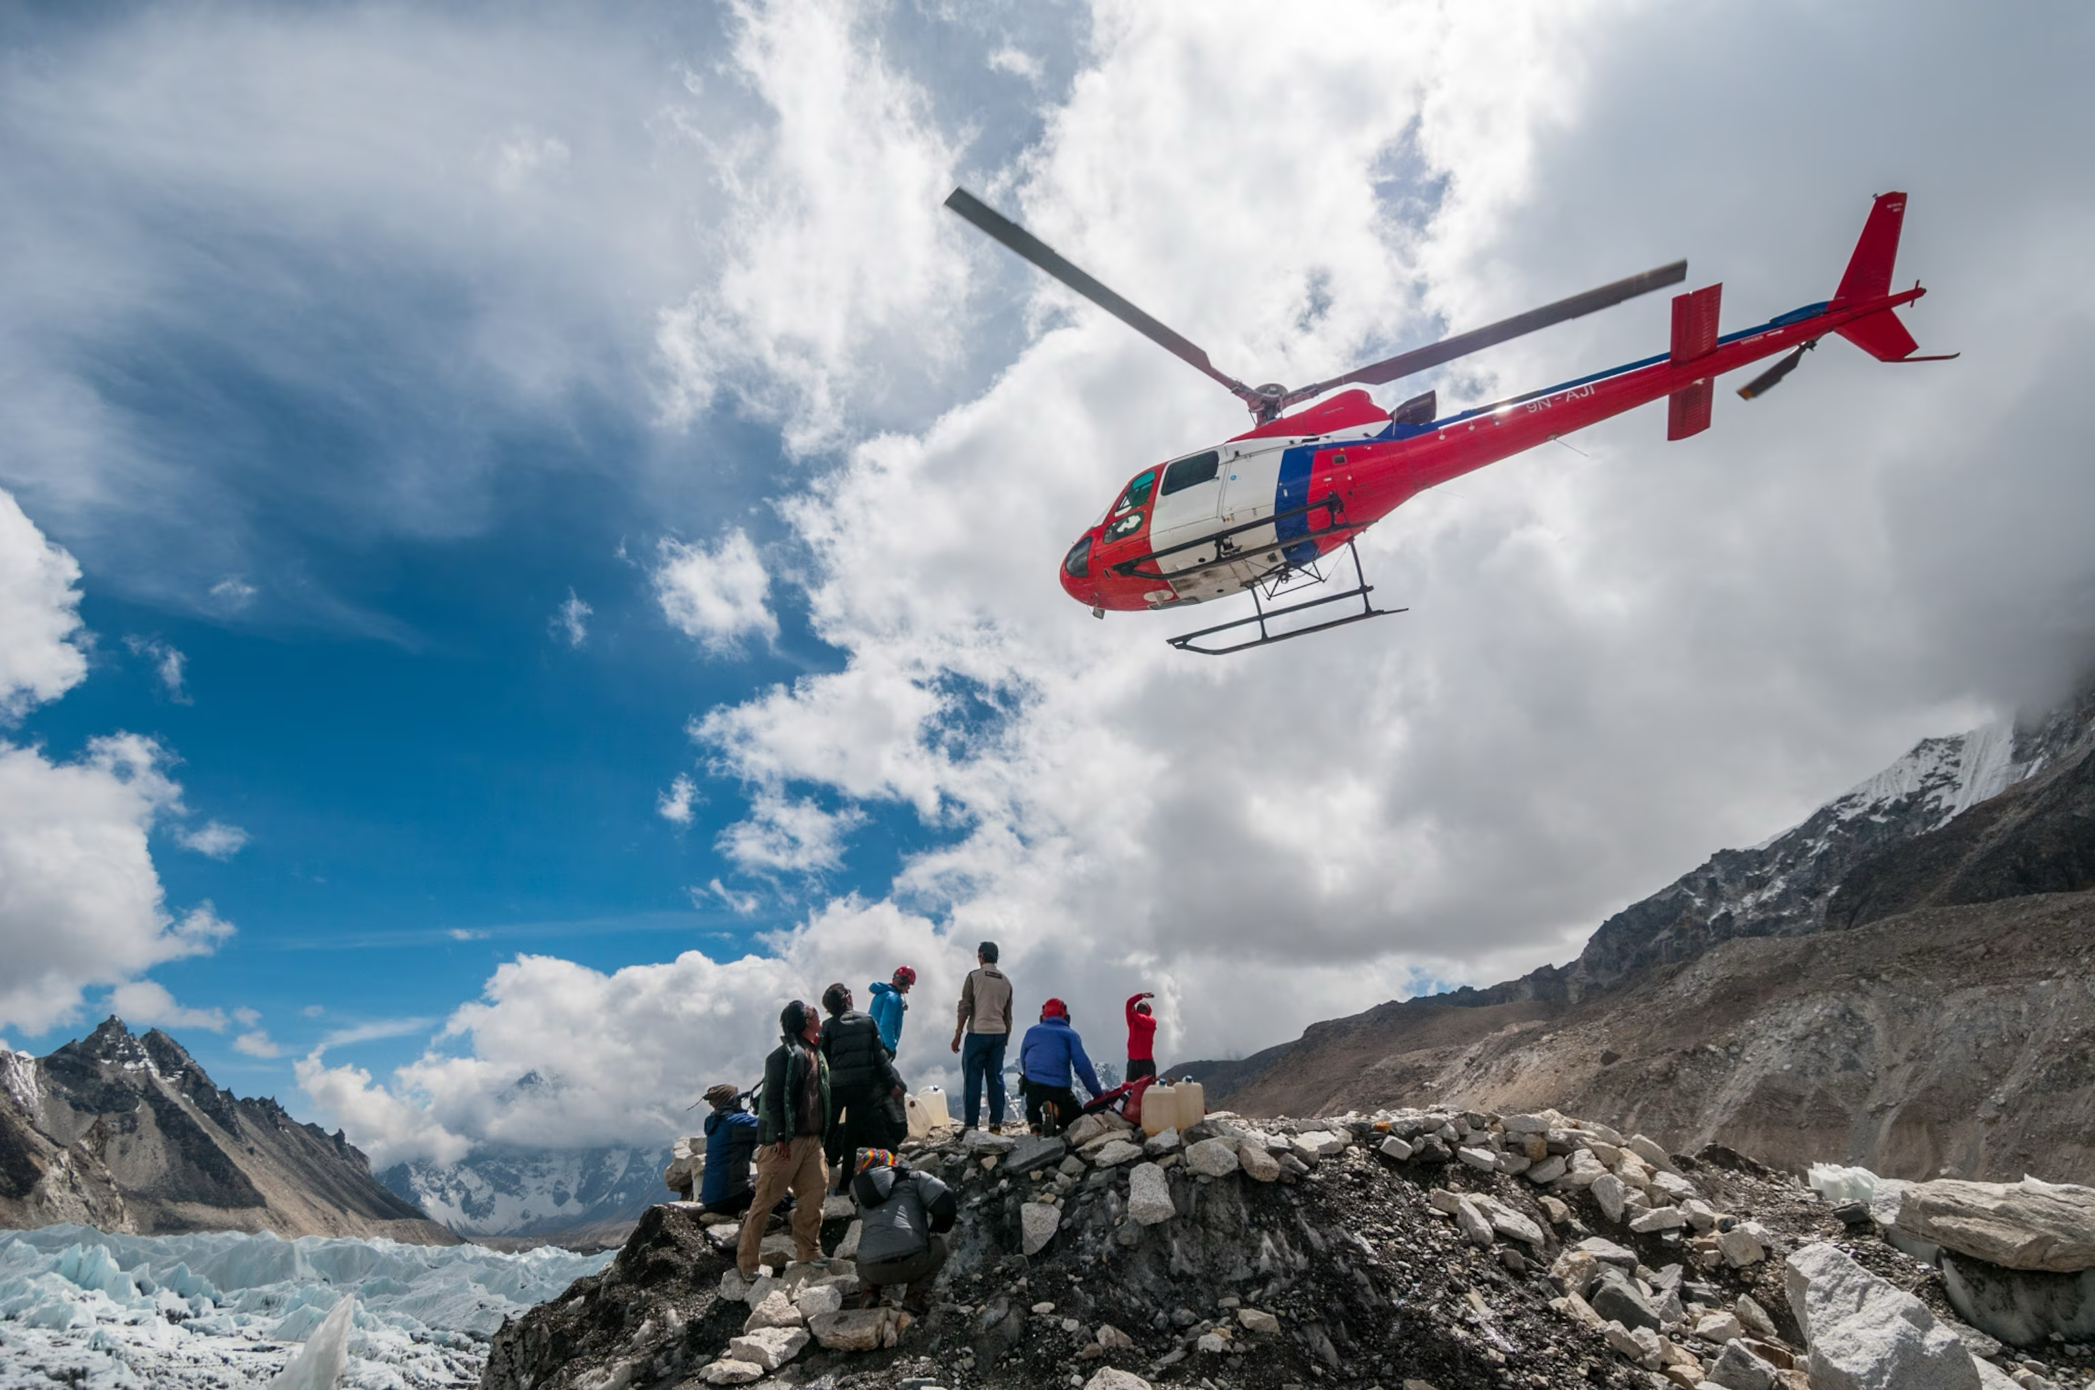
Goal: Reduce Response Time of Rescues and First Aid

Slide 3
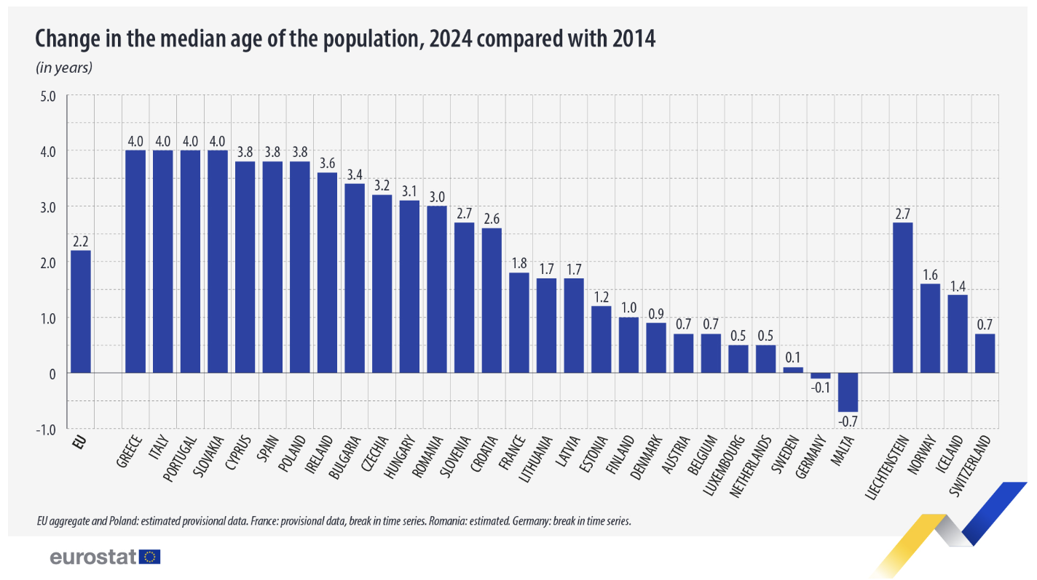
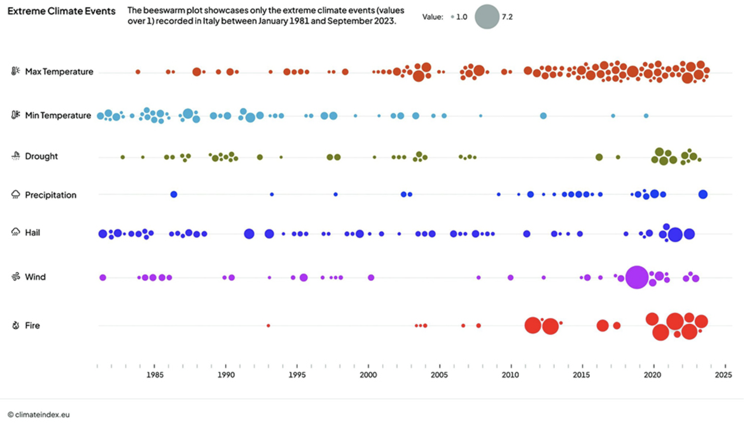
Market Analysis and Opportunity
AGING POPULATION | +2.2 YEARS 2014-2024
CLIMATE EVENTS NUMBER GROWTH | ITALY 1981-2023

Slide 4
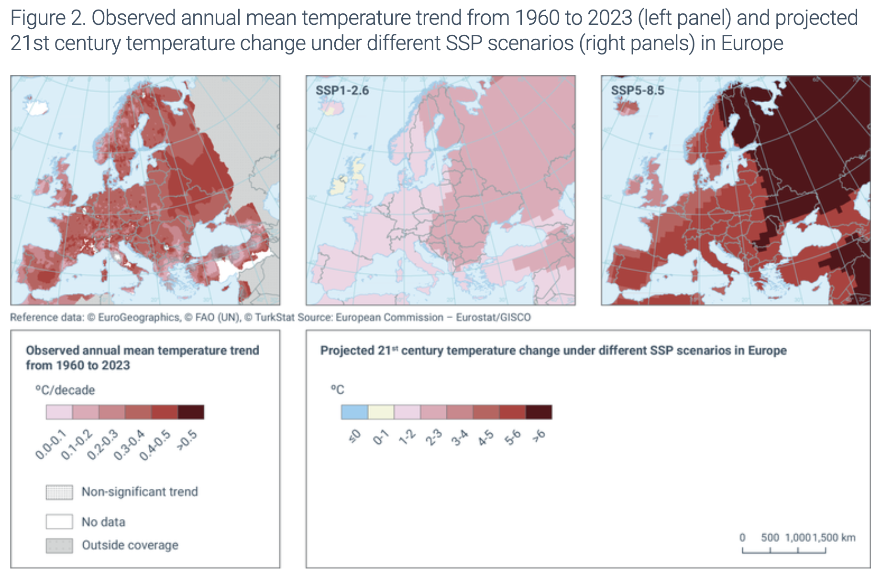
Market Analysis and Opportunity
AGING POPULATION | +2.2 YEARS 2014-2024
RISING TEMPERATURES | 1-2°C BY 2050

Slide 5



European Ongoing Space Initiatives
IMERA (LAUNCH: MID 2026)
IRIS SQUARE (LAUNCH: 2030)
POTENTIAL FOR
EUROPEAN FUNDING

Slide 6
Market Analysis and Opportunity
CLIMATE EVENTS NUMBER GROWTH | ITALY 1981-2023

Slide 7
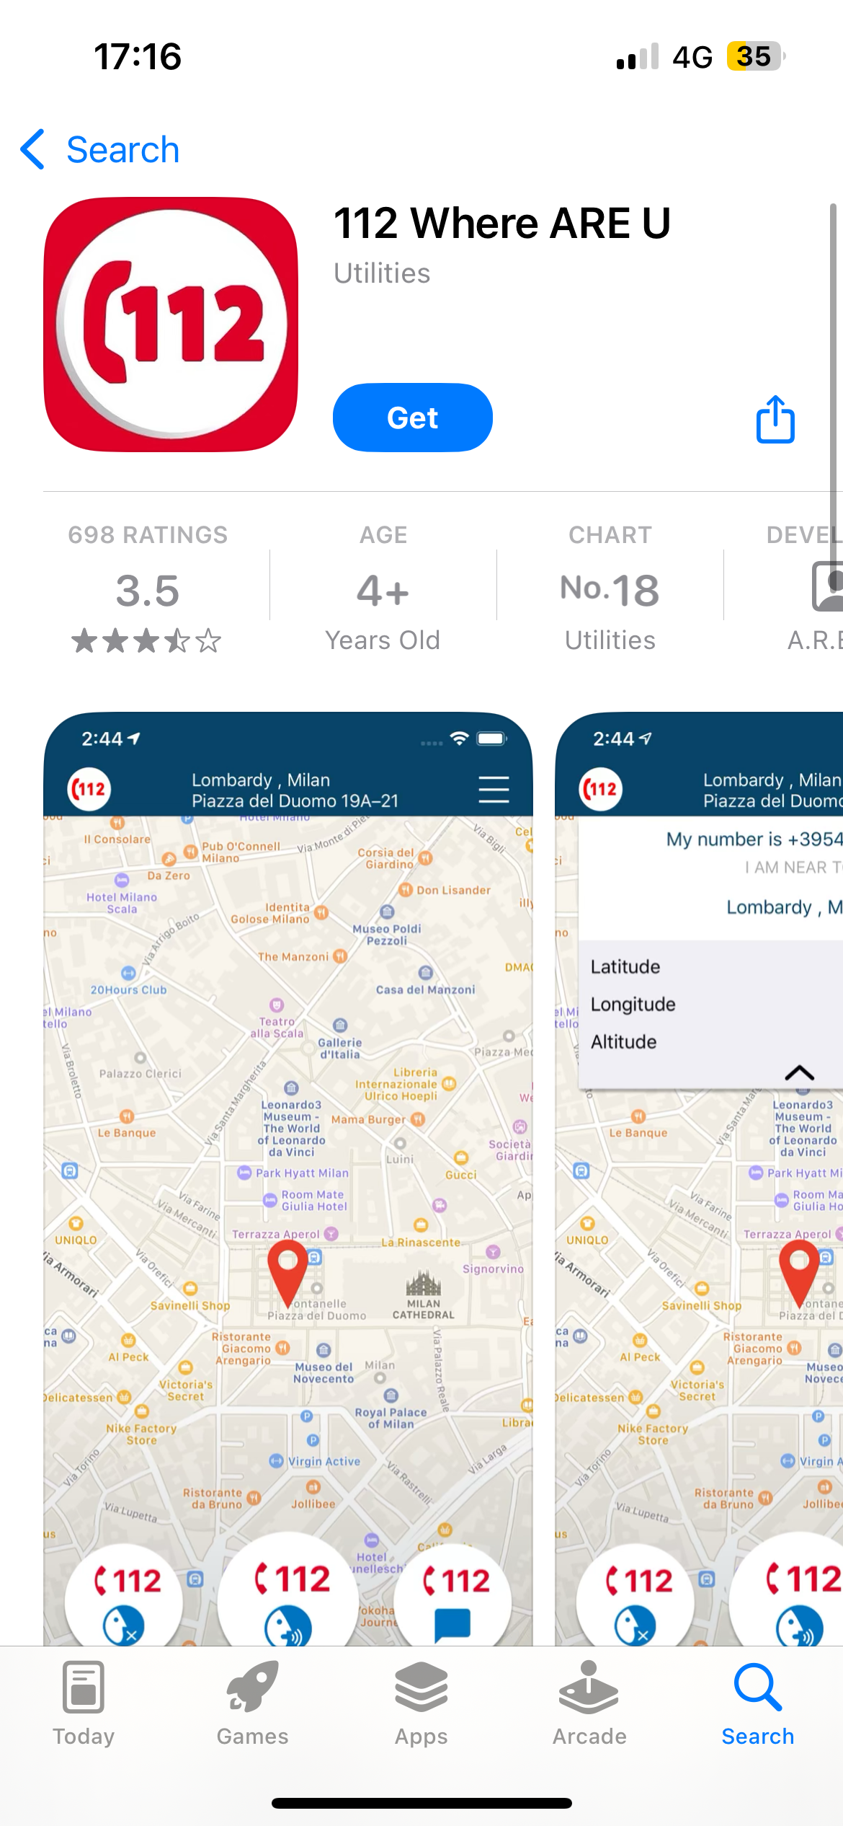
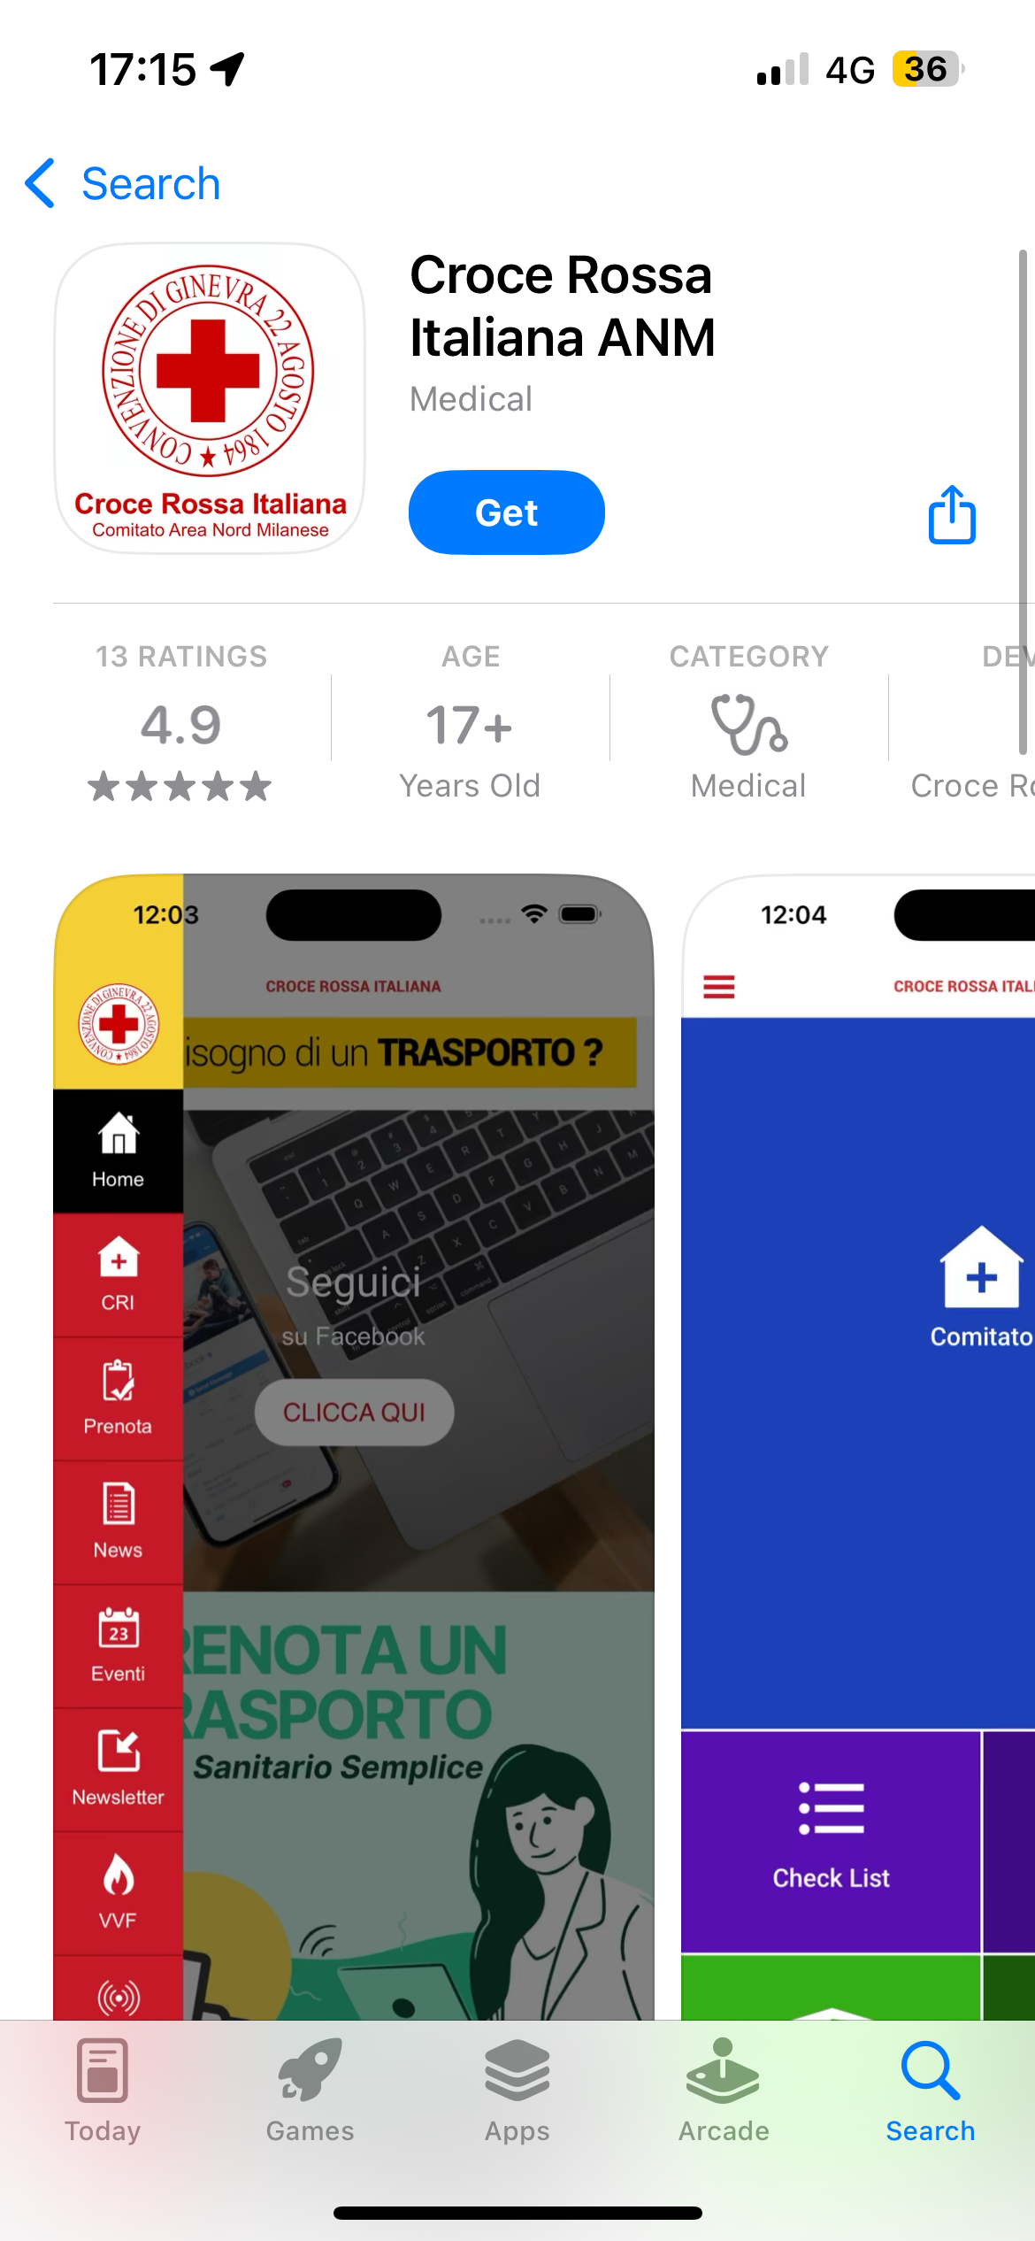
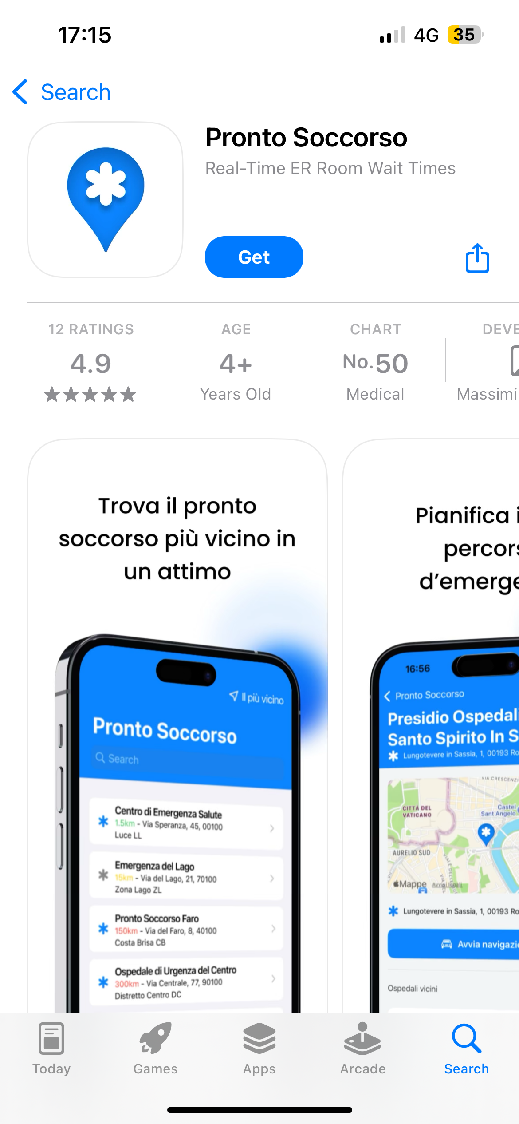
Existing Localization and Informational Apps

Slide 8


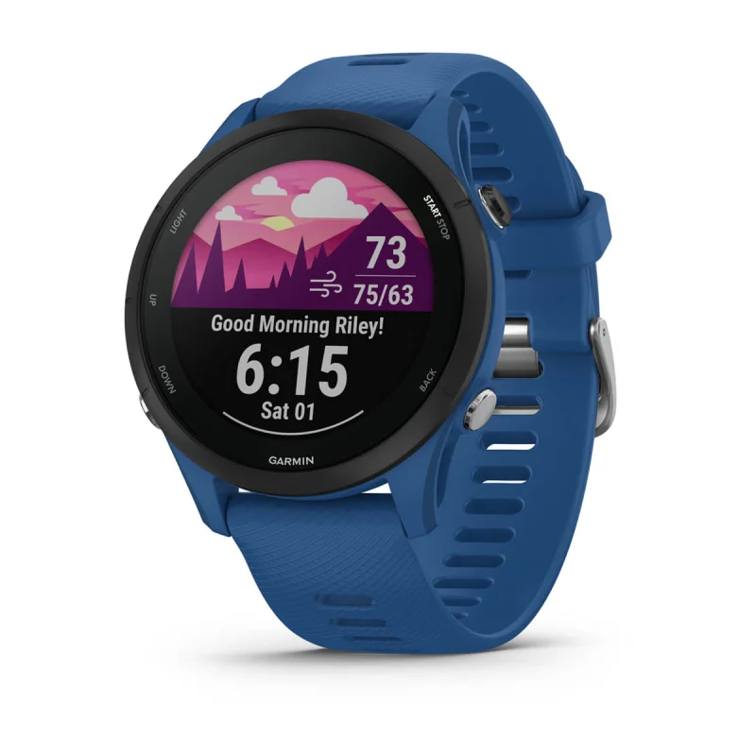
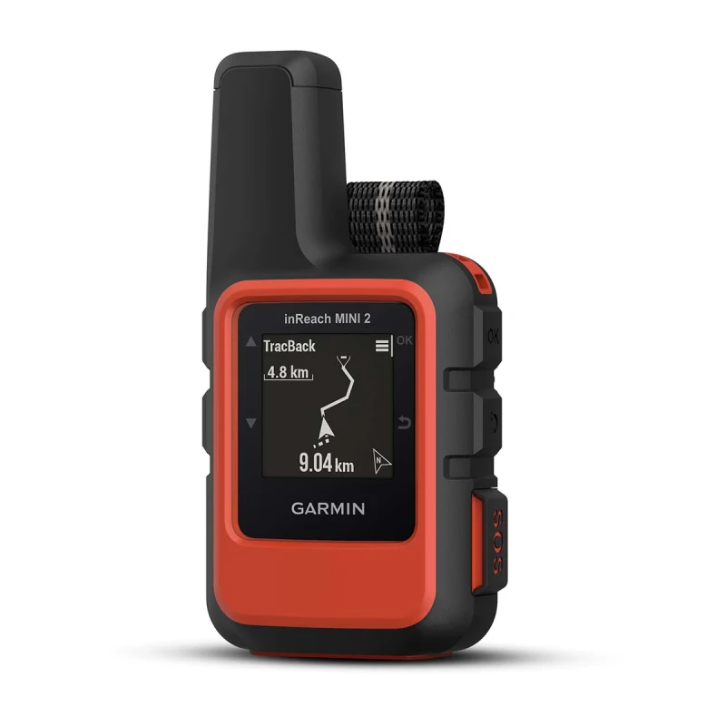
Existing Emergency and Satellite Services
BEGHELLI “SALVALAVITA” POCKET & PHONE
GARMIN FORERUNNER & INREACH
SYSTEM INTEGRATION OPPORTUNITIES

Slide 9
Our Proposal: AIRA

Slide 10







7 Ways to Handle Emergencies
VOICE
TEXT
SATELLITE CONNECTION
112 NUMBER
LIVE MEDICAL SUPPORT
PERSONAL CONTACTS
IN-APP GUIDES

Slide 11
Project Development

Slide 12
Video Demo

Slide 13


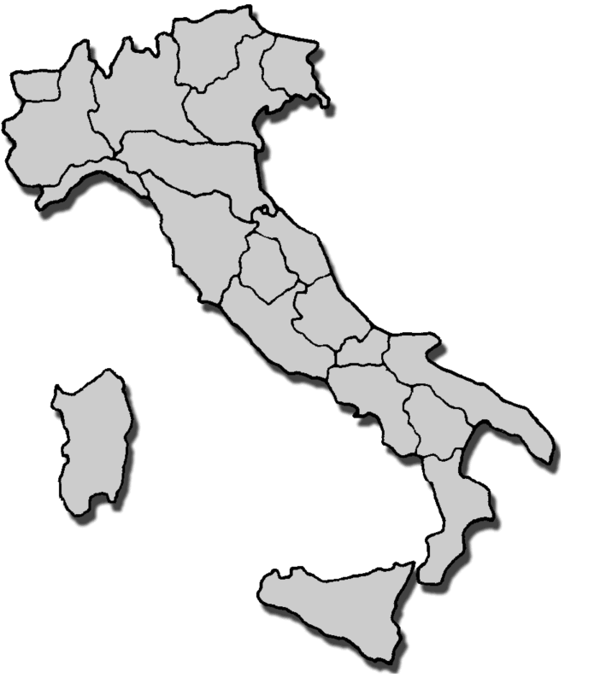



Roadmap 2025 - 2030
2030
2029
2028
2027
2026
2025

Slide 14




Our Team
ALESSIO PRATO
ALESSANDRO MARCELLINI
ALESSIO GANZAROLLI
B.Sc. Computer Science student
UNIBO Motorsport Team Member
Computer Engineering student
UNIBO Motorsport Team Member
Frontend Developer
Computer Science student
NICOLA RICCI MACCARINI
LEONARDO PINNA
Computer Science student
YouTube Content Creator
Computer Science student

Slide 15
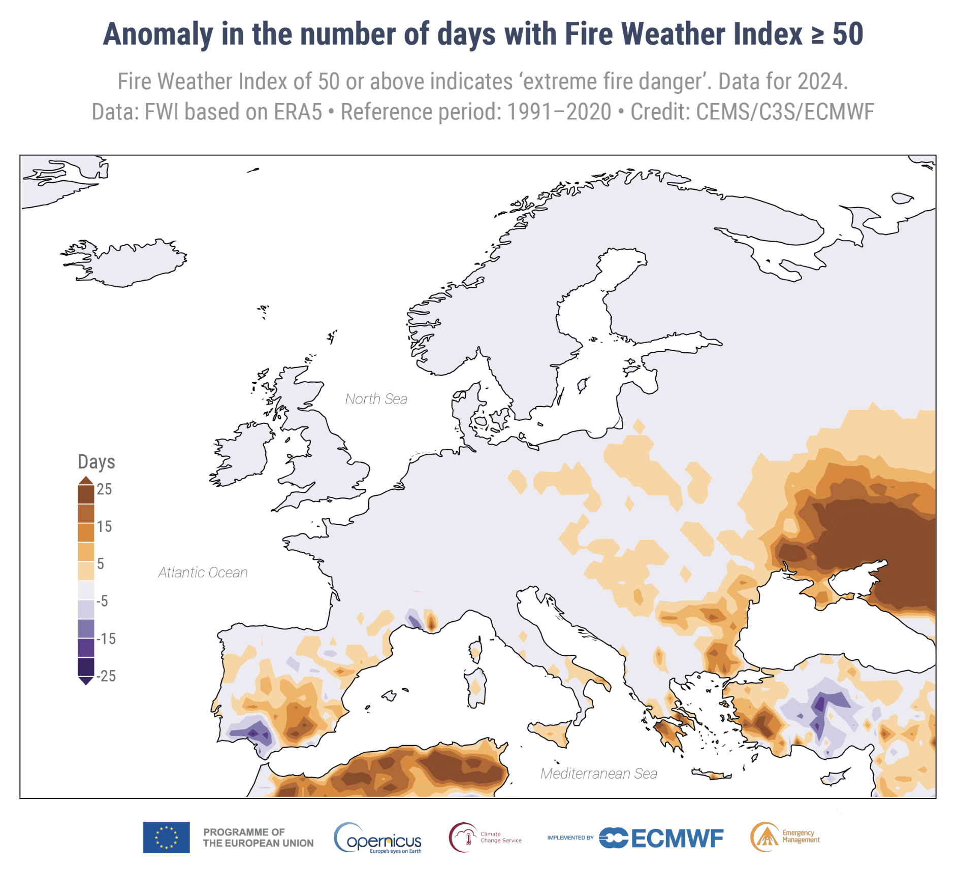
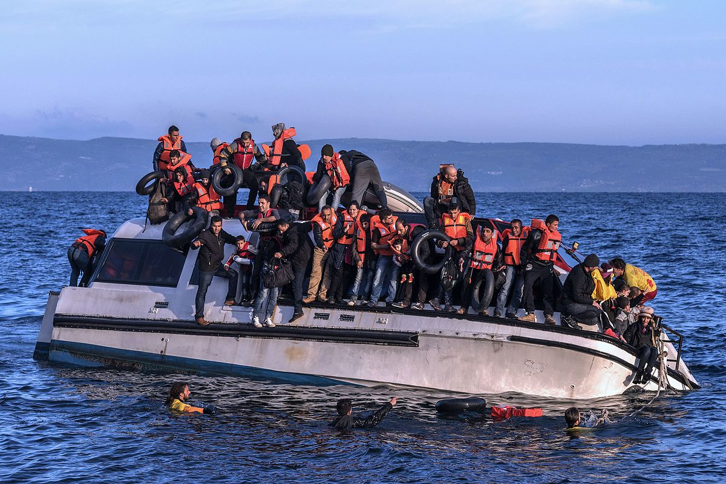
Goal: Improve humanitarian emergencies prediction

Slide 16
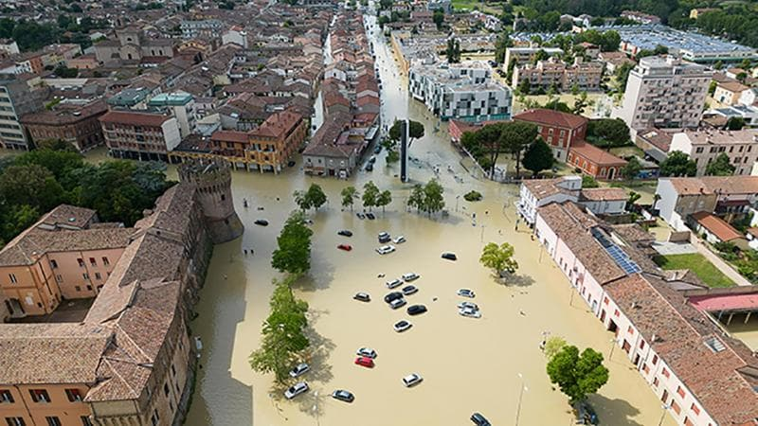
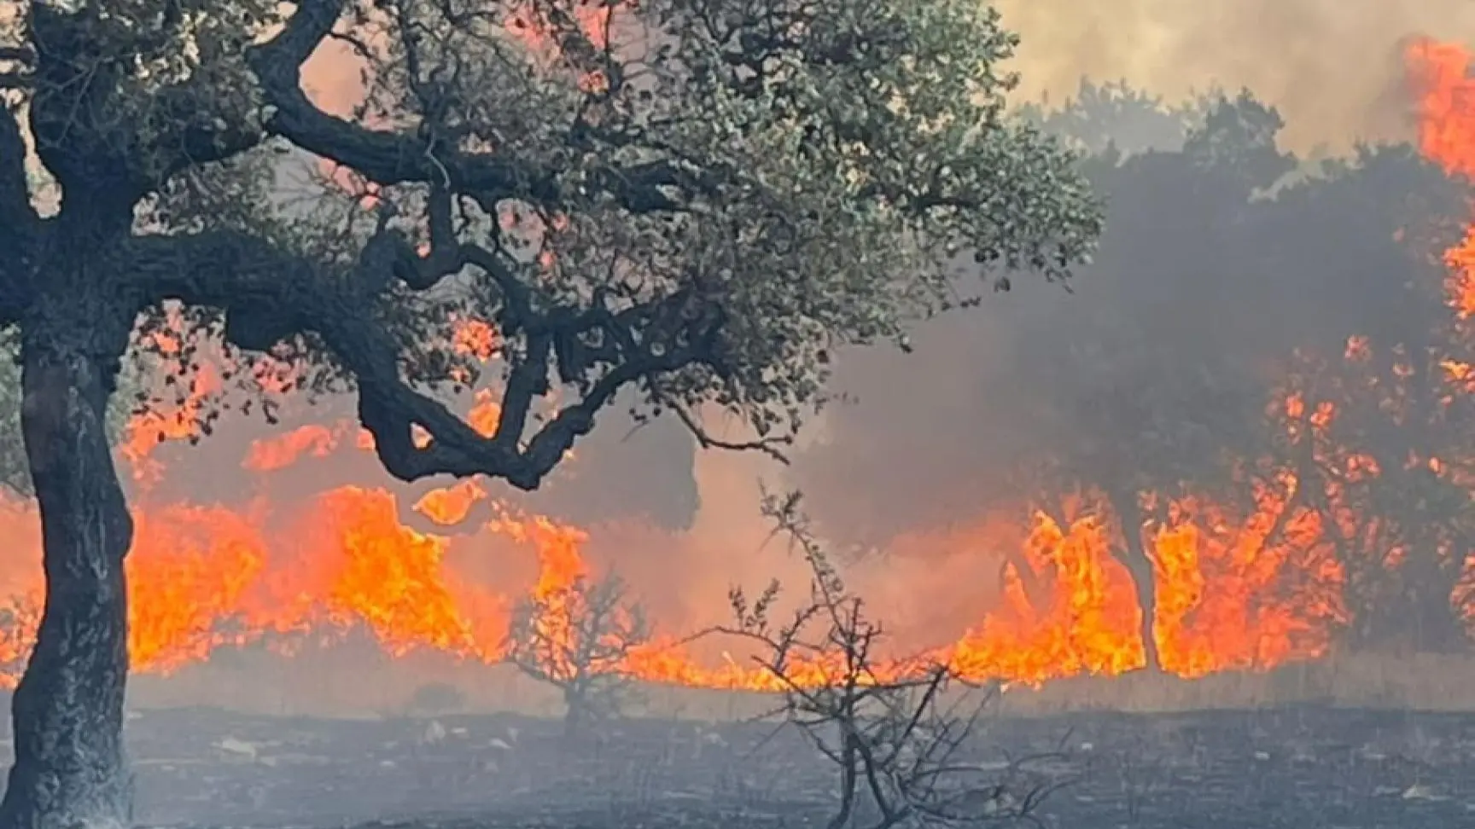
Goal: Improve Climatic Emergencies Organization
Romagna flood, May 2023 – Emilia-Romagna, Italy
Fire advancement, Summer 2024 - Sardegna, Italy

Slide 17
Italy – 2024 Data
~275.000 firefighters' interventions (2.670 per day!)

Slide 18
Problem
What do you do when you are in danger?
What do you do when you see others in danger?
Panic and paralysis?
Call 112 for help?
What if they were late?
What if there were no available connections?
What if you can’t write your message for help?
Use AIRA!

Slide 19
What is AIRA?
Geo-localization and satellite data collection
AI-enhanced data analysis
Improved time to response to rescue
SOS management system with112
ALL IN ONE APP!

Slide 20
Our Value Proposition
Easy to use – One-tap help requests
Efficient – Innovative routing algorithms using data
Reliable – Data driven decisions

Slide 21
Future Extra Features to Keep Users Engaged
Gamification (ping ogni 3 mesi, numero di vite salvate come gioco, ecc..) – Spaced repetition for better use of AIRA features
Battery evaluation to reduce drain
Drone altitude management

